Slide 1
SHUVIT
PS 1 : DEVELOP A POLICE FEEDBACK SYSTEM

Slide 2
PROBLEMS​
Feedback on police operations is challenging due to outdated methods and privacy concerns.​
Traditional approaches like inspections and direct calls lack inclusivity, impeding a comprehensive understanding of community sentiments.​
The current feedback methods are non-digital, missing standardized quest records and a uniform tracking system.​
Limited manpower inhibits daily follow-ups, complicating efforts to address policing issues effectively.​
The diverse, less digitally aware community adds complexity to the feedback process.​

Slide 3
FEAR

Slide 4
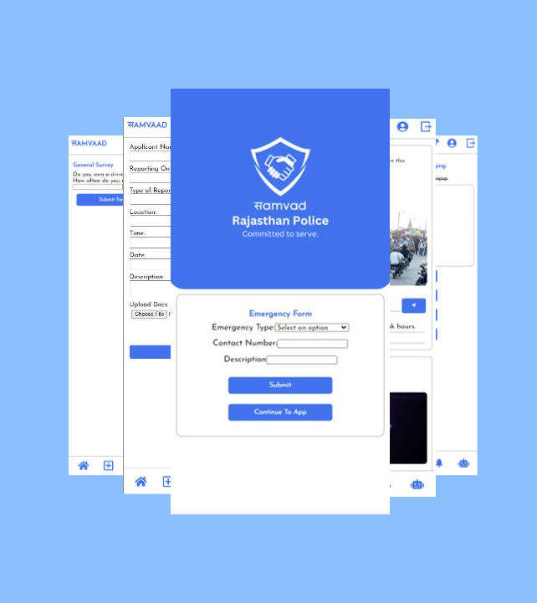


Slide 5
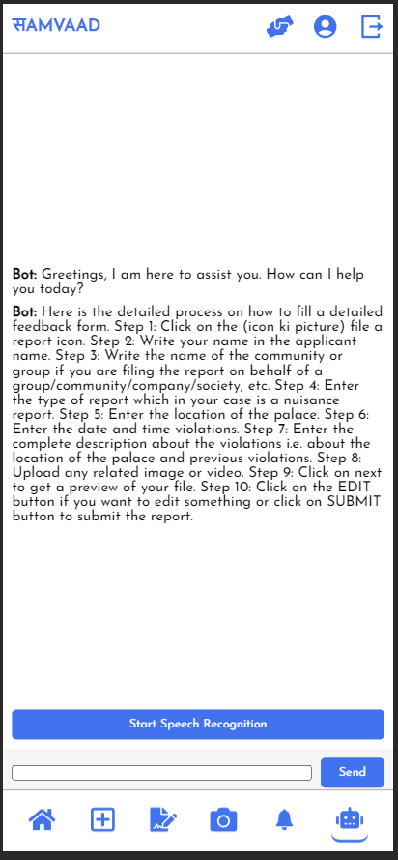
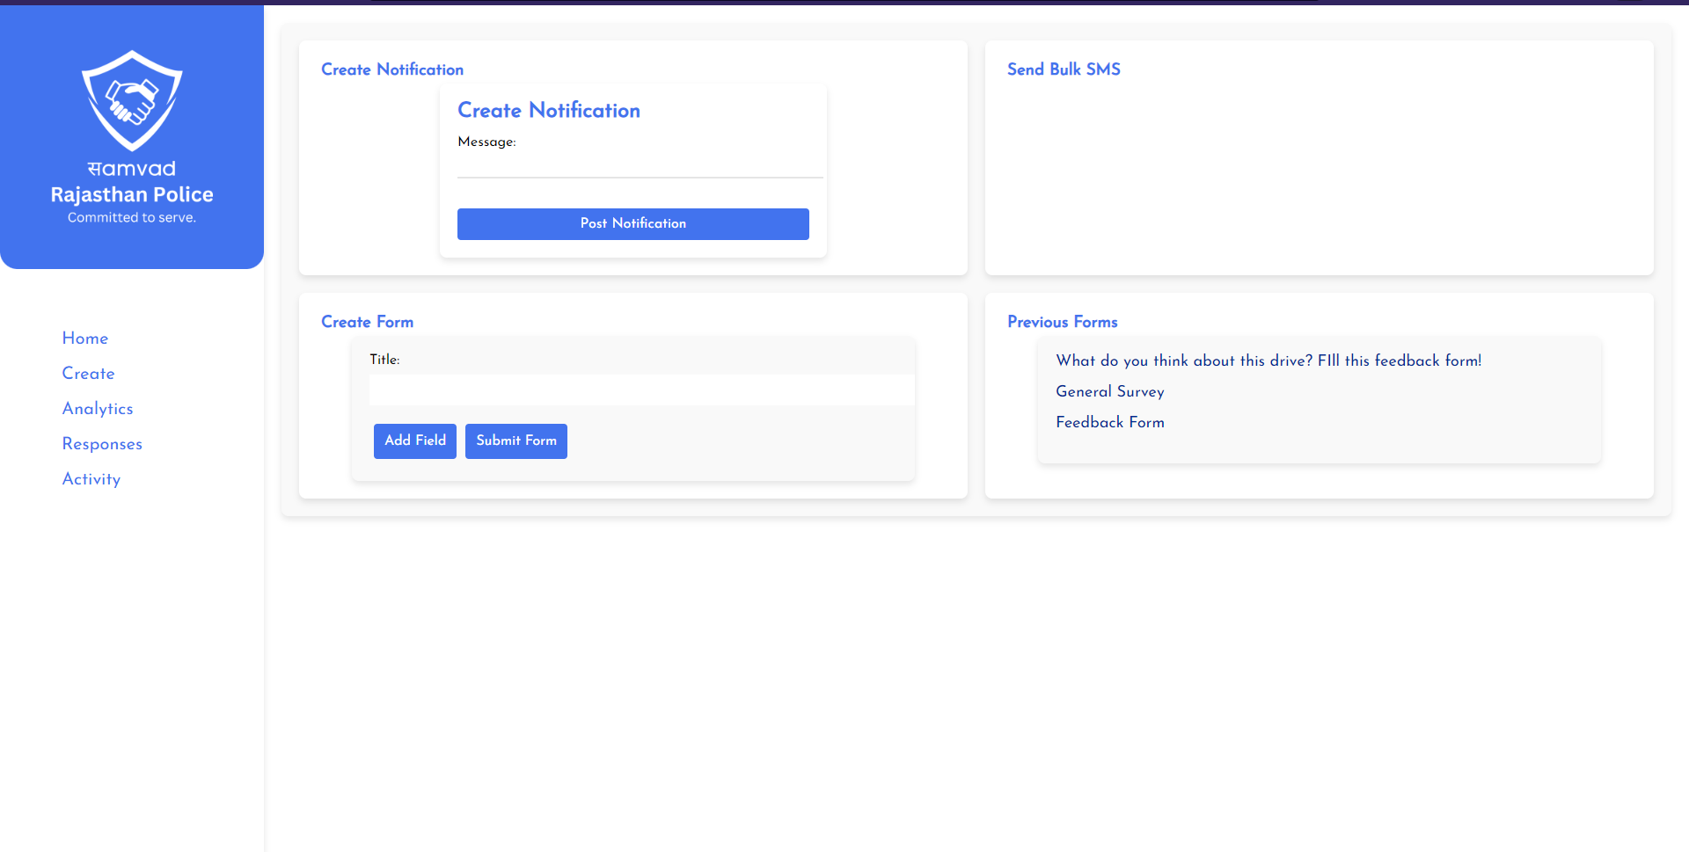
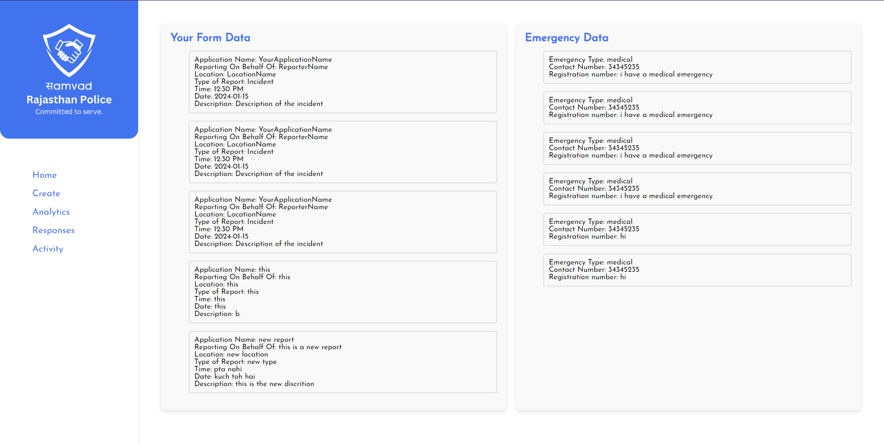
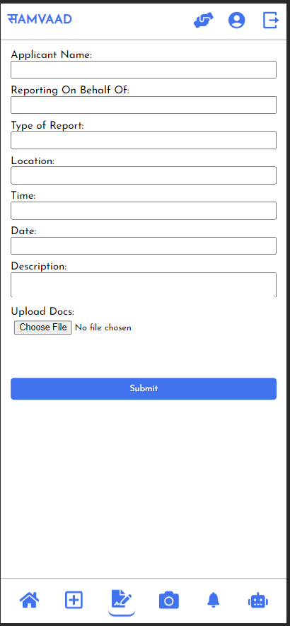
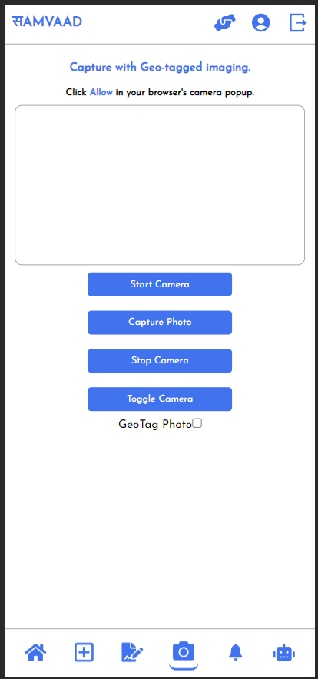
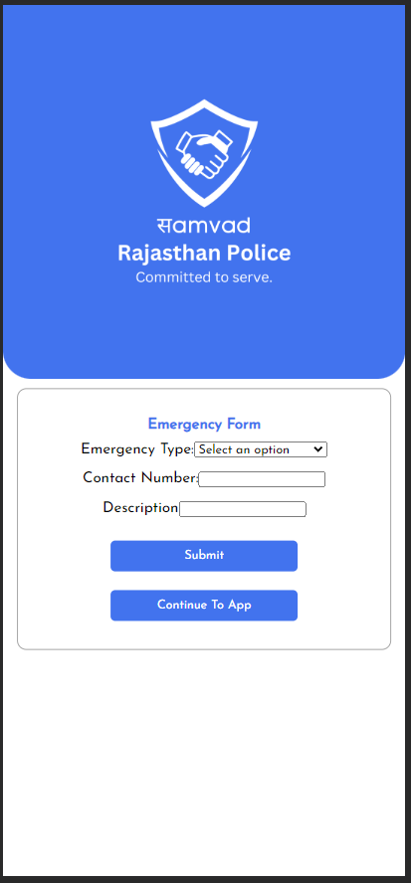
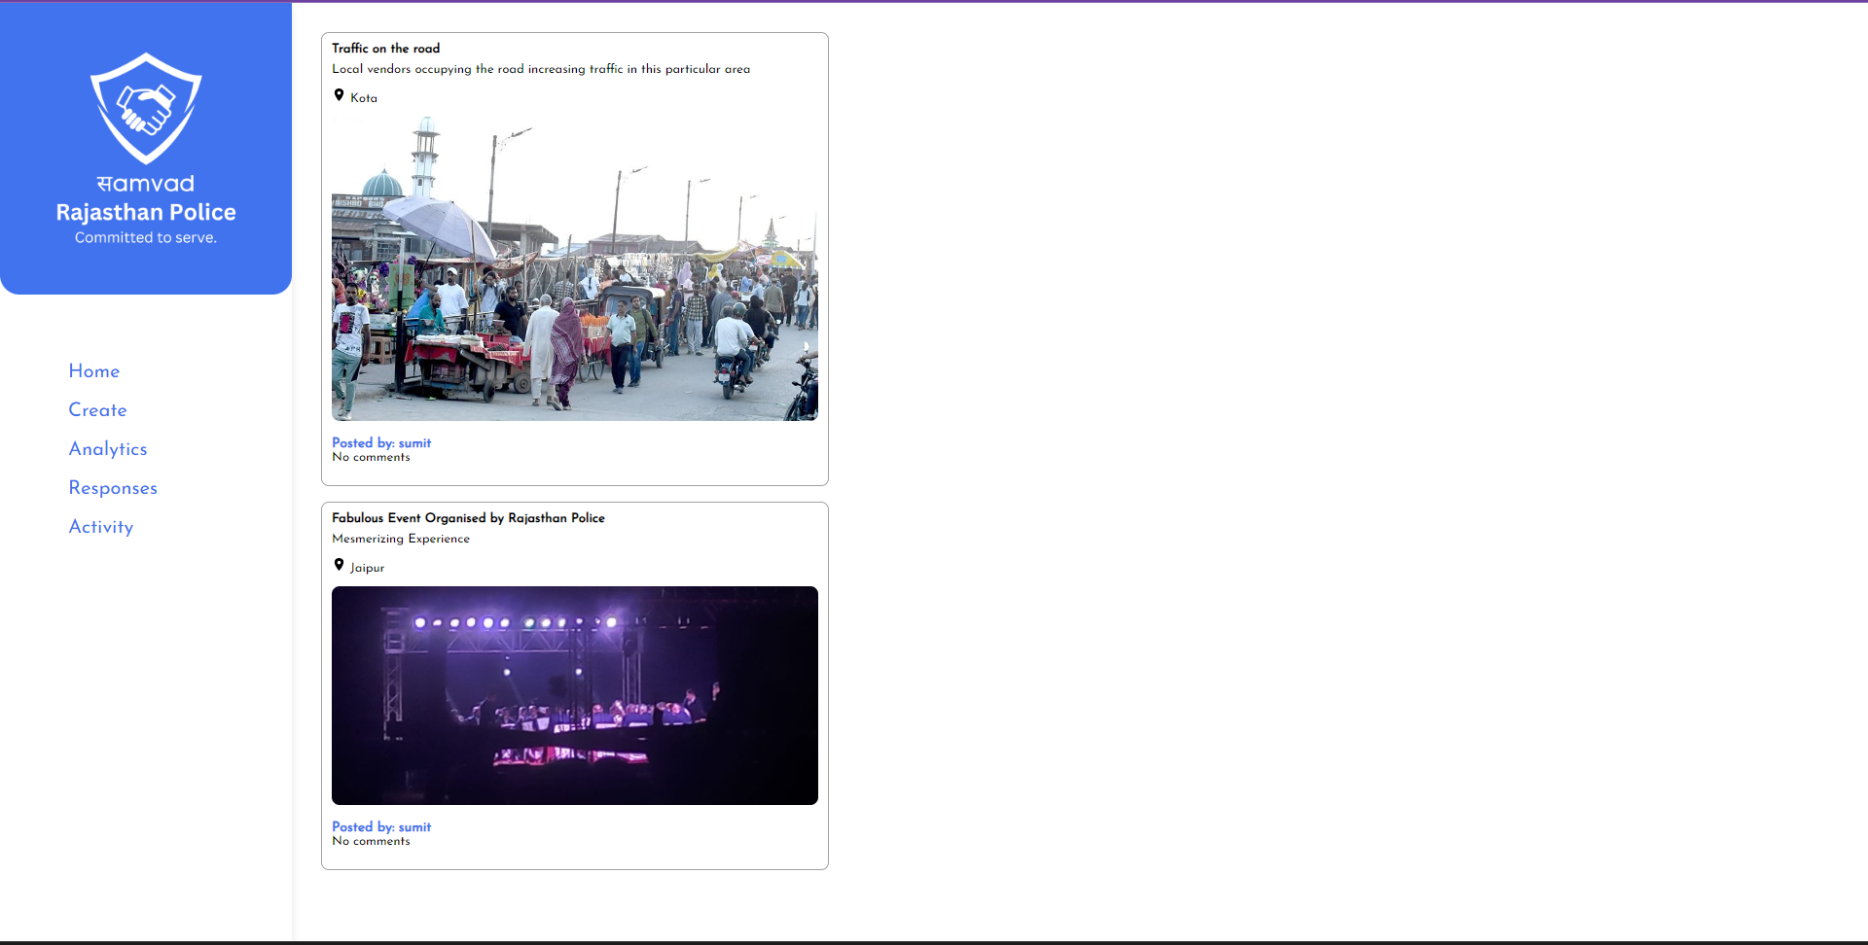
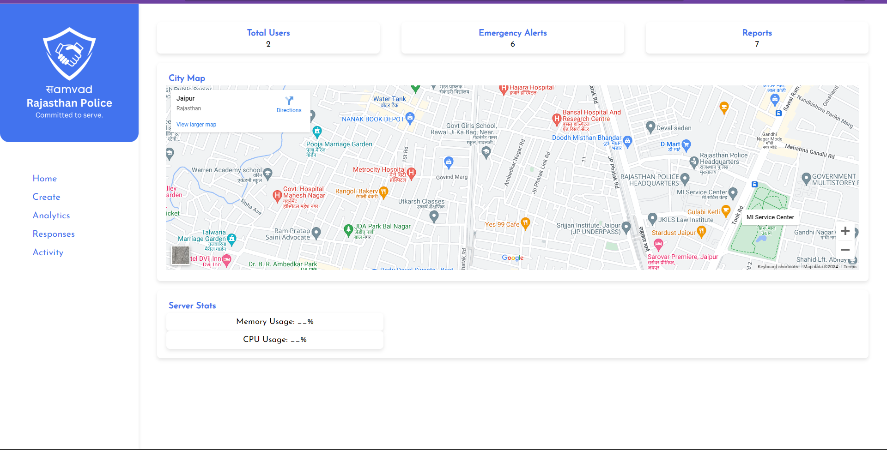
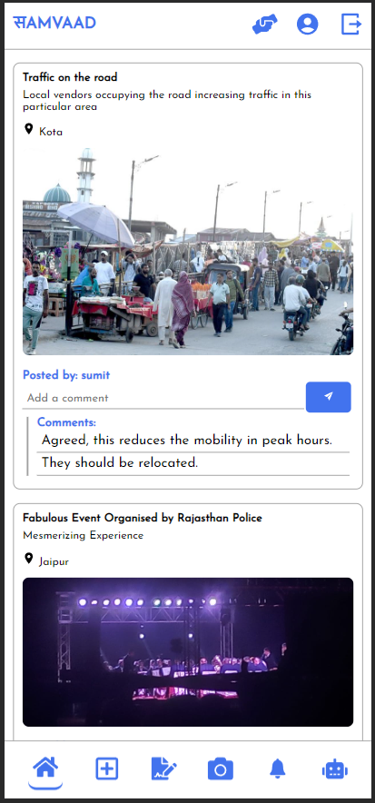
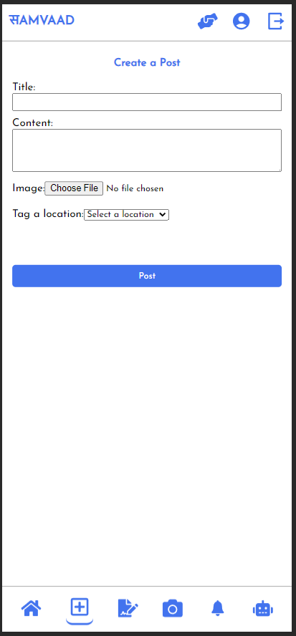
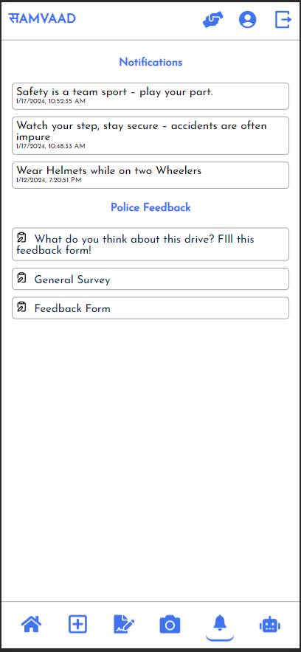
INTERACTIVE USER INTERFACE

Slide 6
Emergency​ Call​ Hotkey​
Provides live location for ambulance escort like services​
Get easy access to contact the nearest policemen/service van

Slide 7
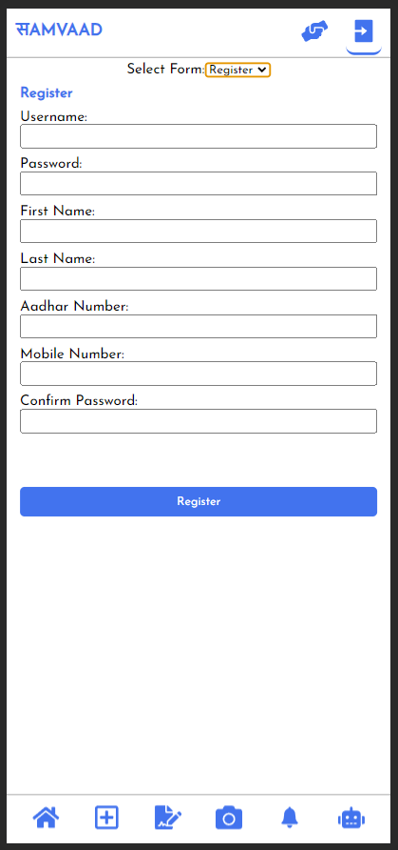
User Registration
Adhaar card verification is a crucial step in our user registration.​
Backed by research, over 130 million Indians are registered, making Aadhaar a highly reliable identification method.​
Adds an extra layer of security, significantly reducing spam accounts and allowing only authorized users.​

Slide 8
Socializing​ Platform
Allow users to upload and share images, videos, and documents related to potential criminal activities.​
Geotagged enabling option for location-specific reporting.​
Users can host polls to gather opinions on proposed reforms or actions to be taken by law enforcement.​

Slide 9
Report Filing​
User can file FIR and reviews for their police interaction.​
Enable users to upload media, such as pictures or documents, relevant to their report.​
Allow users to choose the type of report they want to file, such as FIR, general rating, or a review of police station services.​
Incorporated with geotagging features to capture the location of the incident.

Slide 10
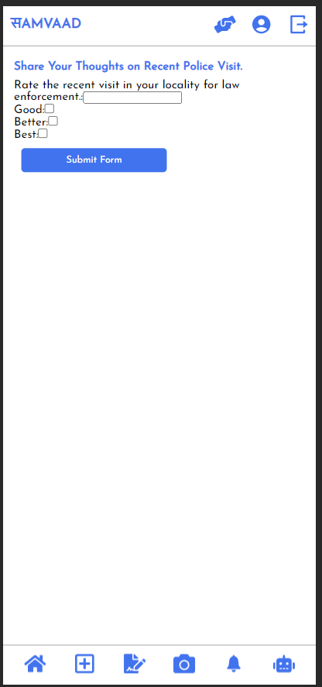
Feedback Form
A platform for users to share their experiences, opinions, and thoughts on campaigns and drives organized by the police department.​
Predefined categories and prompts streamline the feedback process for quick and efficient analysis.

Slide 11
Alerts & Notifications​
Important Notifications and Alerts:​
The police department utilizes this platform to send crucial notifications and alerts directly to users.​
Users receive real-time updates on emergencies, safety advisories, and community alerts.​
User Feedback for Campaigns:​
Feedback forms for recent campaigns are conveniently accessible on this panel.​
Users can provide valuable insights, helping the department to evaluate the effectiveness of initiatives.​

Slide 12
Geotagging Camera​
Seamless Location Integration : Our Geotagging Camera seamlessly integrates location data with user-generated content, eliminating the need for manual input.​
Data Segregation : Geotagging facilitates the easy segregation of data based on location.​
Enhanced Report Addressal : Location-specific data enables quicker and more accurate response to reports.​

Slide 13
Chatbot
In this we have integrate auto chat bot which will facilitates real-time analysis of user responses, streamlining the feedback collection process and contributing to ongoing enhancements in our Police Feedback System ​
User can also use our chatbot for navigation purpose which is a great help to less digitally literate part of society ​
We have also included speech input as well to make it easier to navigate through the app features or get any other legal info.​

Slide 14
HOME
Crime Heatmap
Basic statistic like server stats, total users, and reports filed

Slide 15
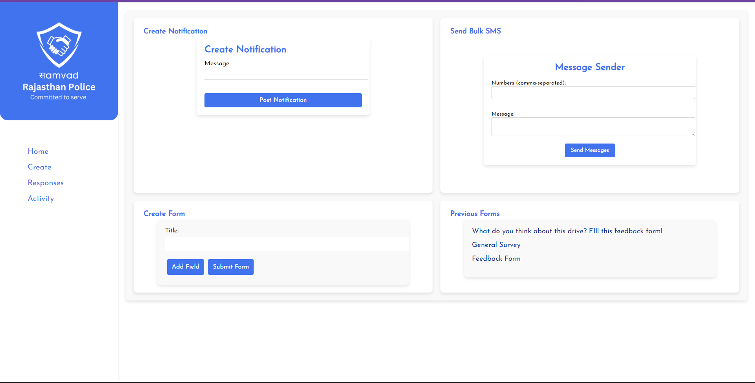
Create Tab
Allows the police officials to create bulk message, notifications , alerts and customize forms for getting responses
Officials can also keep a track of previously sent notifications and alerts.

Slide 16
Activity Tab
This tab will help the officials to monitor and keep a track of the posts uploaded by the users.
The officials can also remove the posts if found misleading or explicit content.

Slide 17
Responses Tab
This tab will help the officials to monitor and keep a track of the posts uploaded by the users.
The officials can also remove the posts if found misleading or explicit content.

Slide 18
Future Developments
Geofencing: Creating geofence for accurate notification, alert and feedback form deliveries
Explicit content removal: We will be integrating the system with an algorithm that will detect any kind of explicit, misleading or fake content and remove it instantly from the platform.​
Concise Feedback Summaries: AI will generate brief summaries of complex feedback, making it easily understandable for both the public and the police department.​
Chatbot-Assisted FIR Input: Our chatbot will simplify the FIR reporting process, converting rough user input into the proper syntax of a First Information Report.​
Police Identification: The Police Identification feature in our system enables users to easily identify the policemen associated with a reported incident. In the event of any misconduct or incident, users can utilize our portal to pinpoint the location of the occurrence. Once the user inputs the location details, our system will promptly retrieve and display images of the policemen assigned to the nearest police chowki, facilitating quick and efficient identification.​

Slide 19



Sumit Chauhan
3rd Year B.Tech ECE
Chandigarh Group of College
Team
SHUVIT
Himanshu Kondal
2nd Year B.Tech IC
NIT Jalandhar
Aditya Chaurasia
2nd Year B.Tech ECE
Chandigarh Group of College

